Slide 1

Large-scale atmospheric response to declines in Arctic sea-ice
Ruth Petrie
Len Shaffrey
Rowan Sutton
TEA-COSI (The Environment of the Arctic, climate, ocean and sea ice)

Slide 2
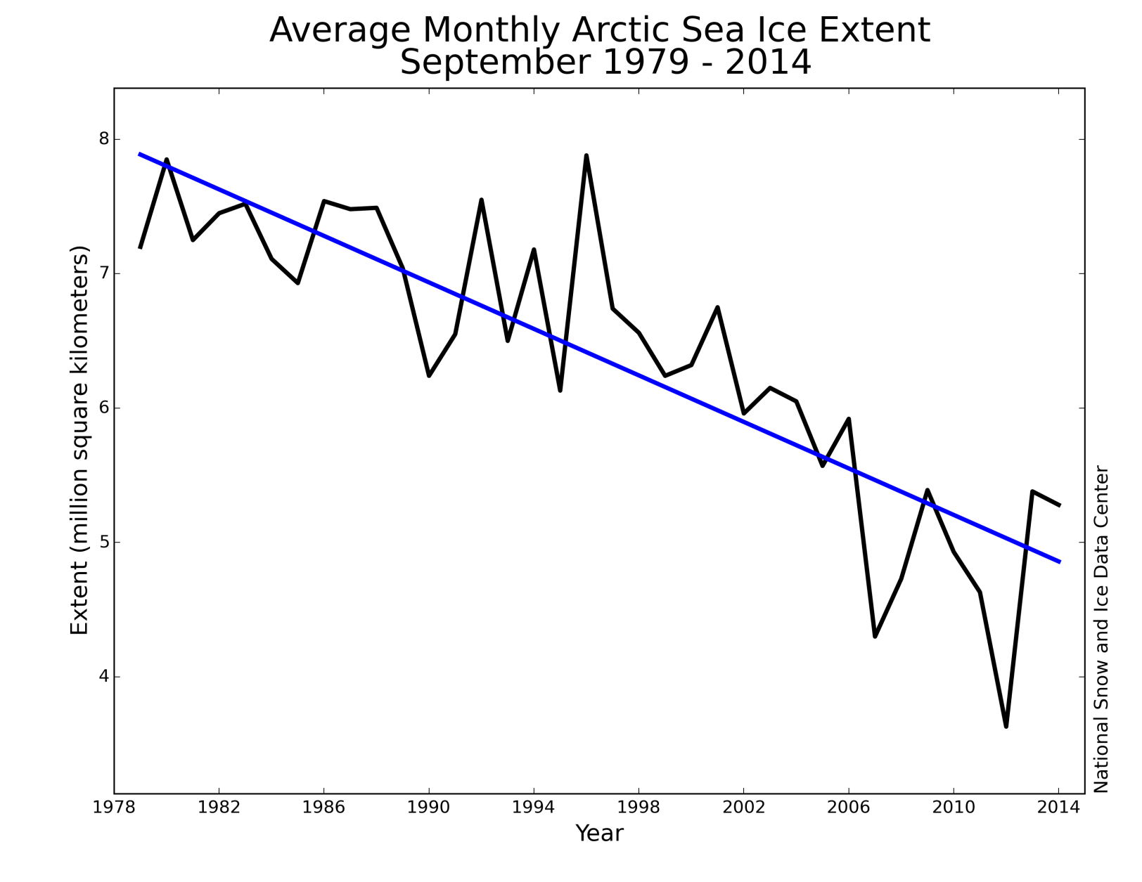
Motivation
Large declines in Arctic sea-ice extent have been observed since ~1980.
2007: Anomalous meridional wind
2012: Great Arctic Cyclone

Slide 3
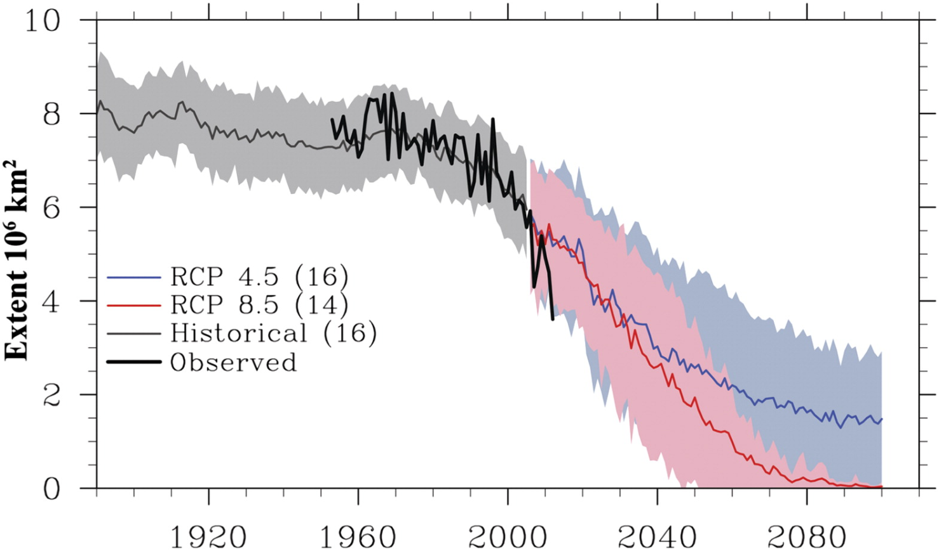
Motivation
Arctic sea-ice cover is projected to continue declining leading to a seasonally ice-free Arctic
Maloney et. al, 2014, J. Clim

Slide 4
Motivation
What are the potential effects of reduced Arctic sea-ice on the mid-latitude circulation?
More extreme weather due to slower propagating waves? (Francis and Vavrus, 2012, 2015)
Metric dependent (Barnes, 2013; Screen 2013)
Projection onto the negative phase of the NAO in winter?
Is the atmospheric circulation response from Arctic sea-ice loss small compared with the natural variability?

Slide 5
Fully-coupled experiment
What is the impact on the atmospheric circulation of declining sea ice in a fully-coupled model?
UM; GC2.0 (vn8.4)
Atmosphere N96L85 ~1.25km horizontal resolution 85 vertical levels
Ocean model is NEMO at 0.25 degree horizontal resolution
Sea ice model is CICE at 0.25 degree horizontal resolution
30 member ensemble of single year integrations
Integrations start on the 1st of April (the start of the melt season)
Ensemble is generated by using 30 different atmospheric start dumps
Perturb the initial conditions of sea ice thickness, maintain the sea-ice concentration

Slide 6
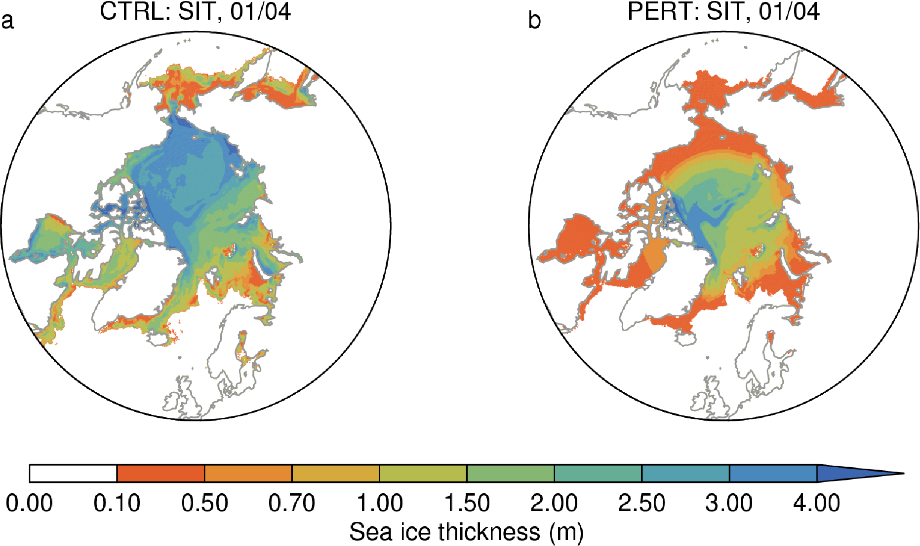
Initial ice thickness distributions

Slide 7
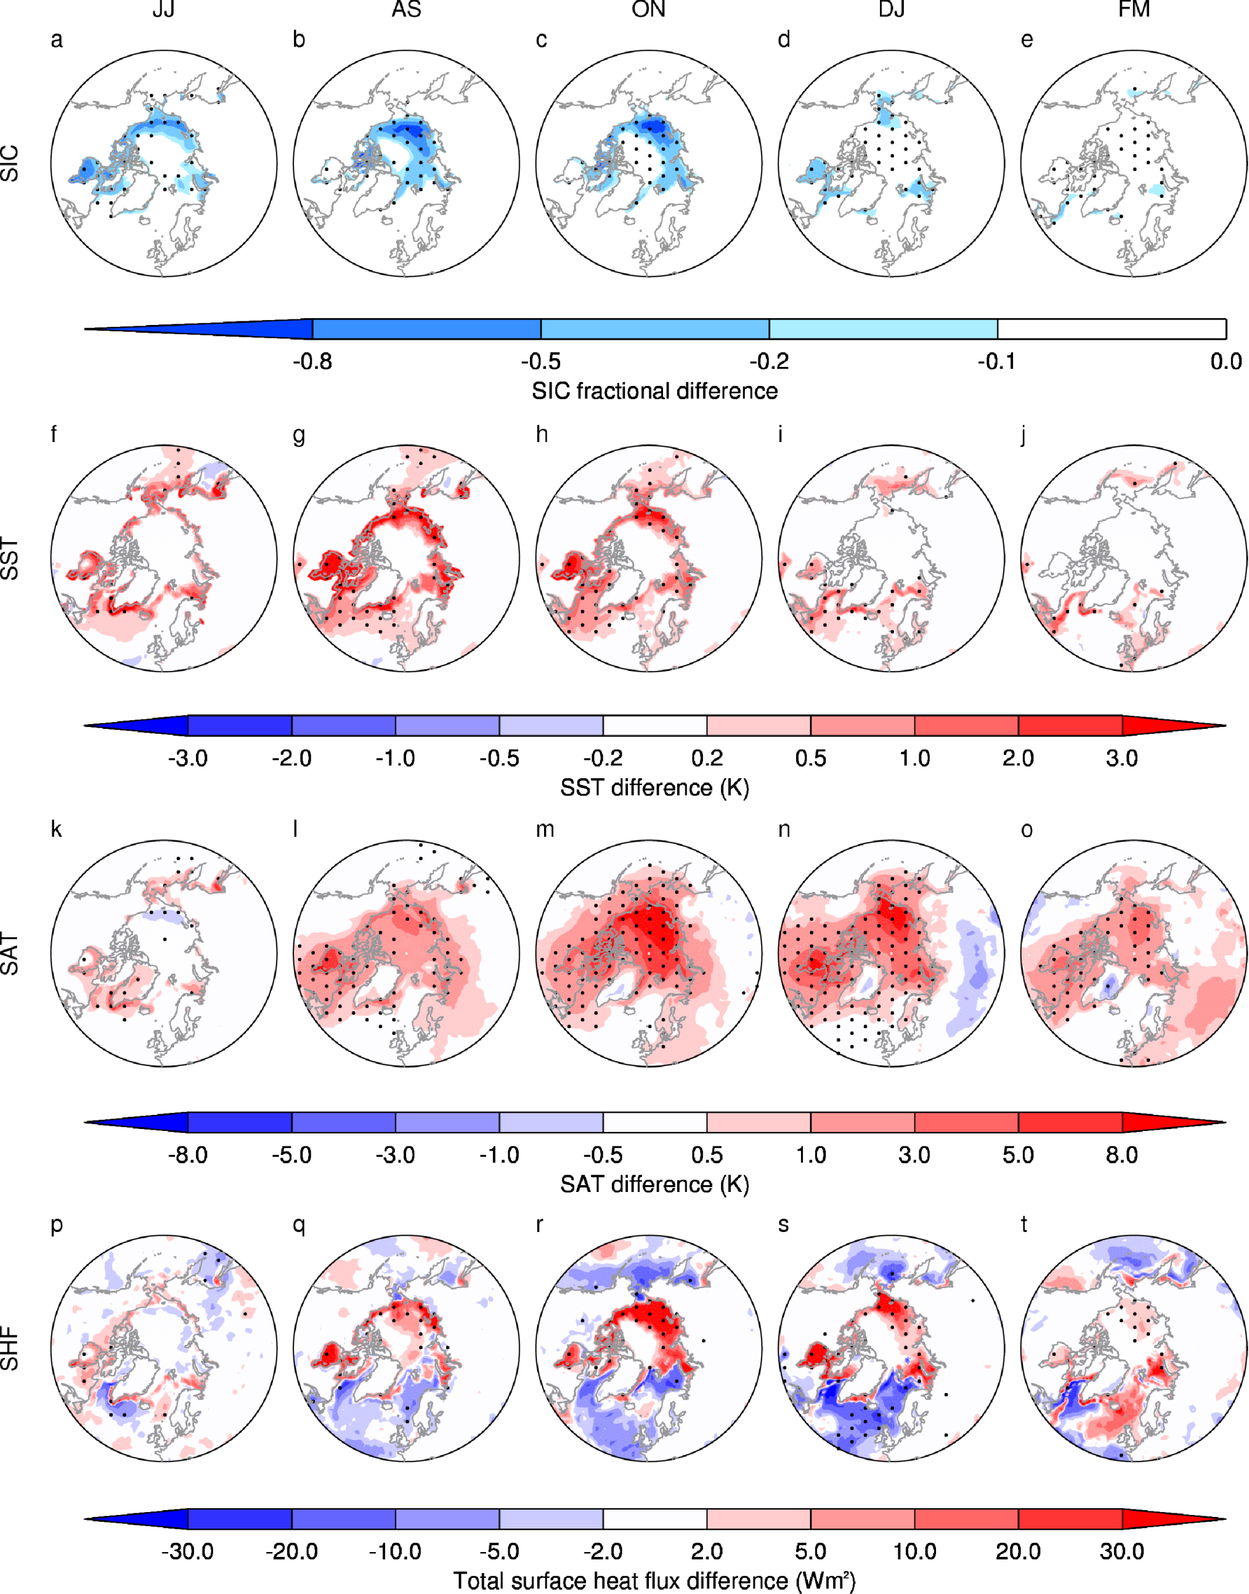
Thermodynamic responses

Slide 8
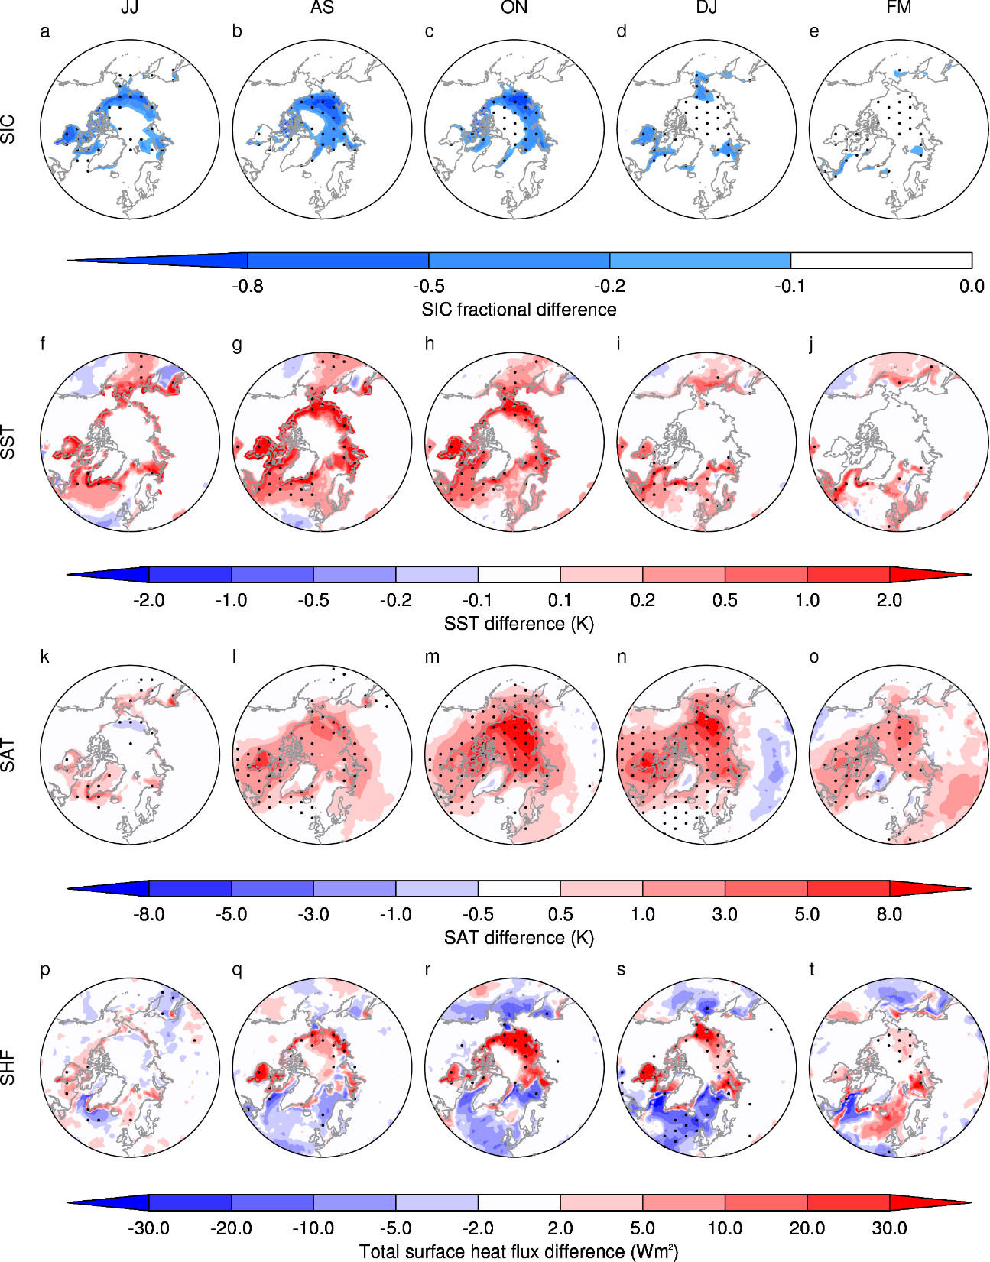
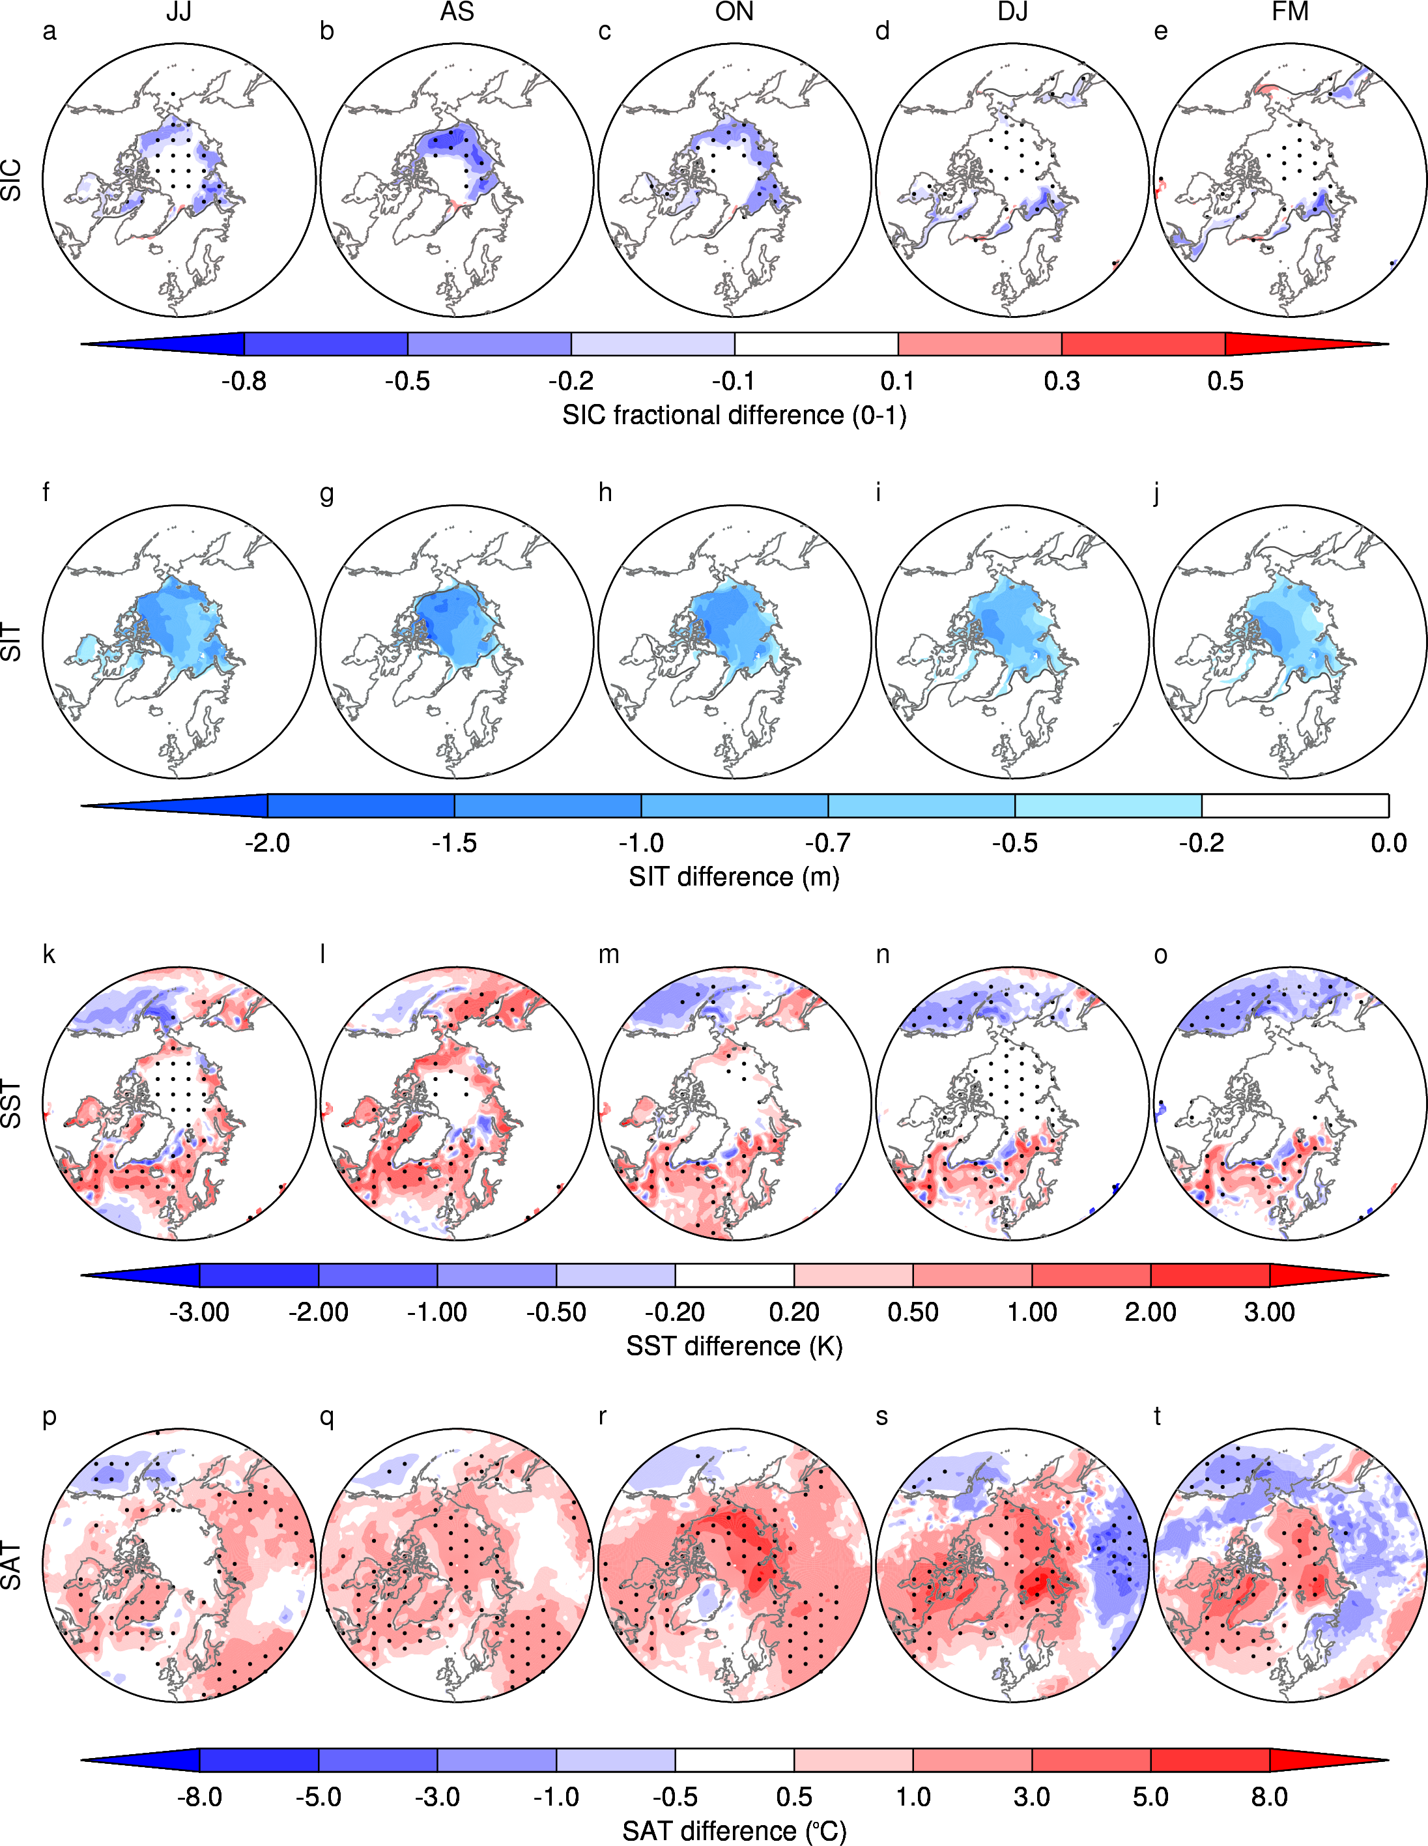
Surface Air Temperature, Oct-Nov
MODEL
PERT-CTRL
ERA-Interim
(2007-2013)-(1980-2000)

Slide 9
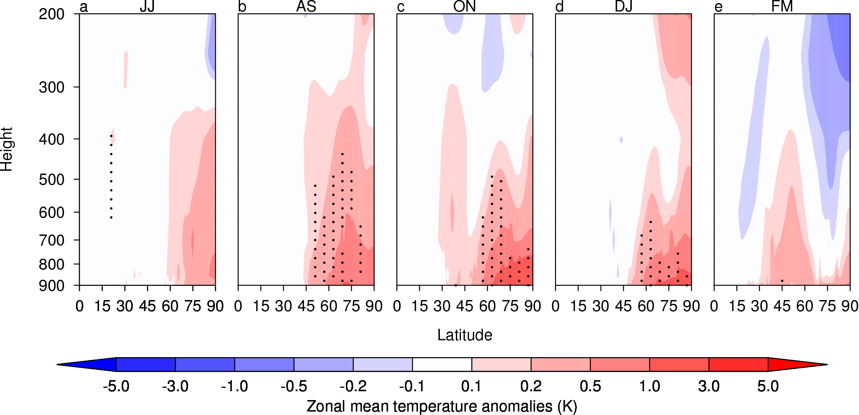
Zonal mean temperature profiles

Slide 10
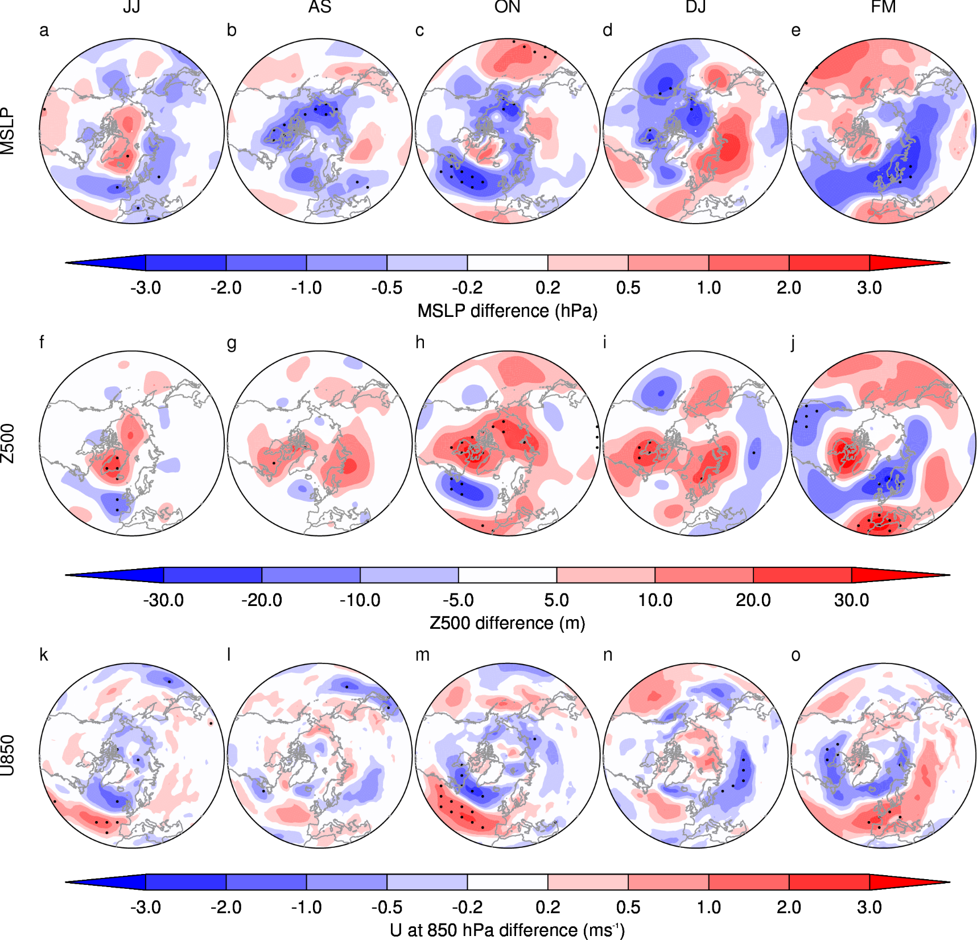
Dynamic responses – June-July
Z500
U850

Slide 11
Dynamic responses – Oct-Nov
Z500
U850

Slide 12
Conclusions
Coupled model results:
Projection onto the summer NAO in JJ.
Southwards shift in the jet in JJ and ON.
No indication of a favoured phase of the NAO in winter, or an tendency for colder winters.
Implications of a coupled model
Coupling allows for a stronger response in SAT.
Would more coupled experiments lead to more agreement.

Slide 13
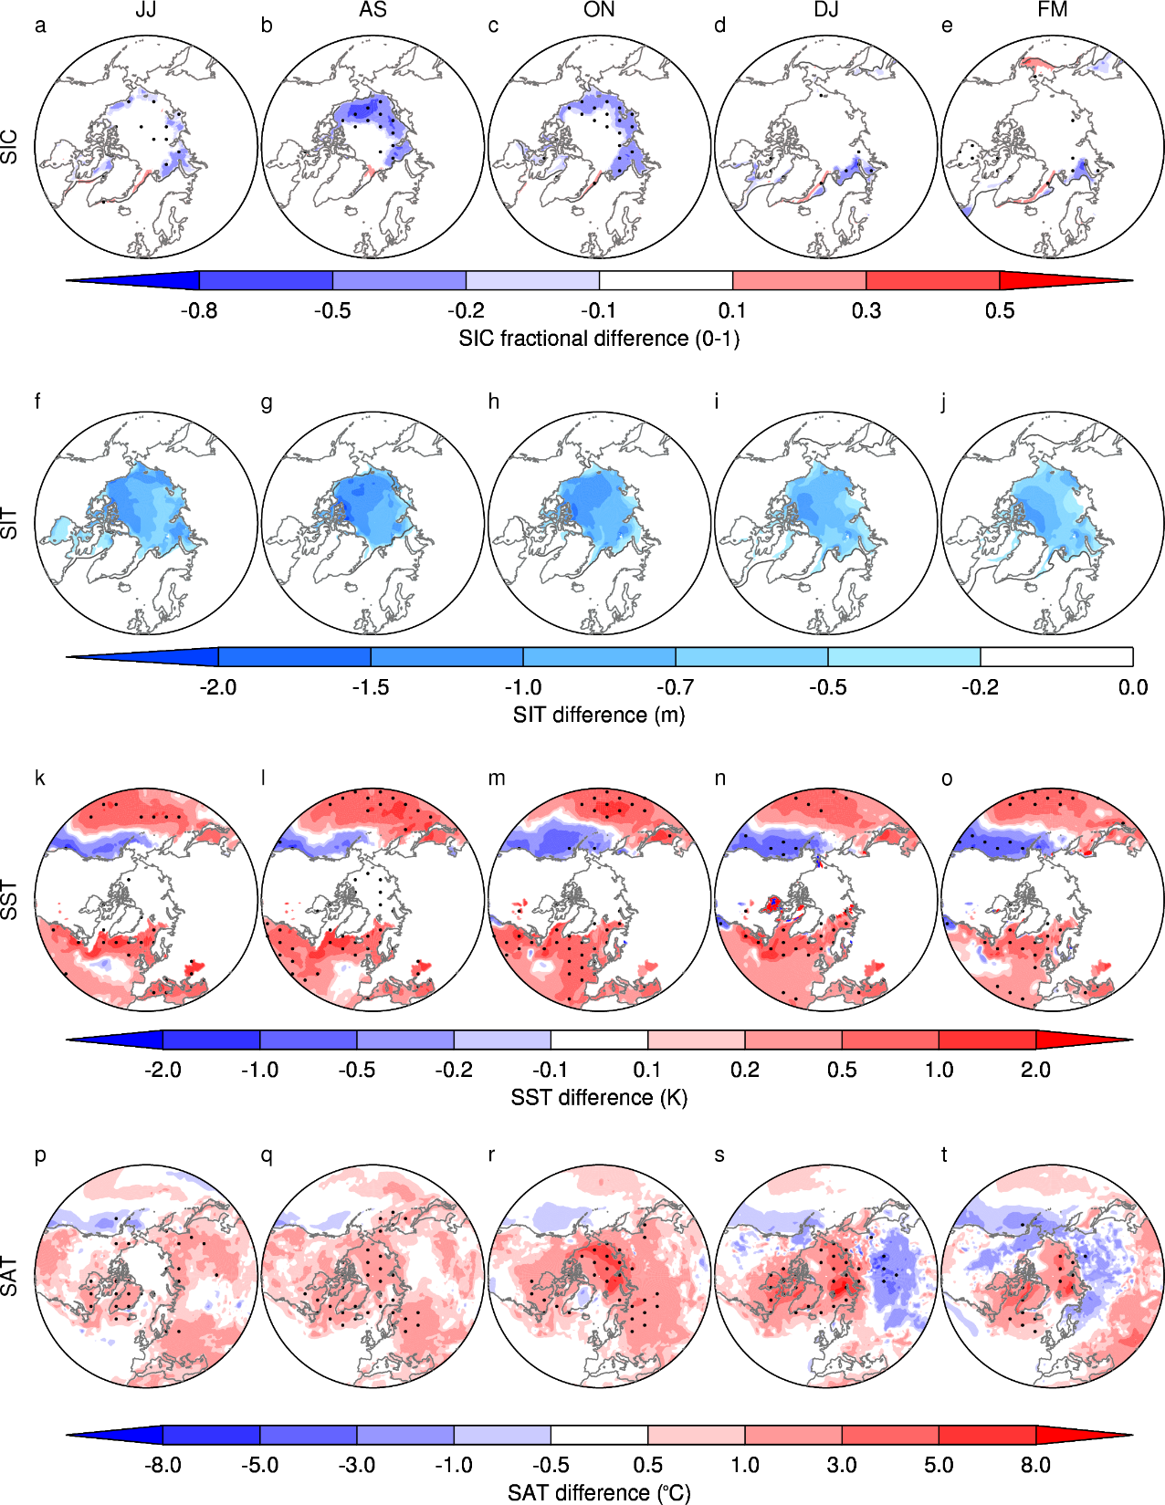
Changes in the Arctic (I)
(2007-2013)-(1980-2000)

Slide 14
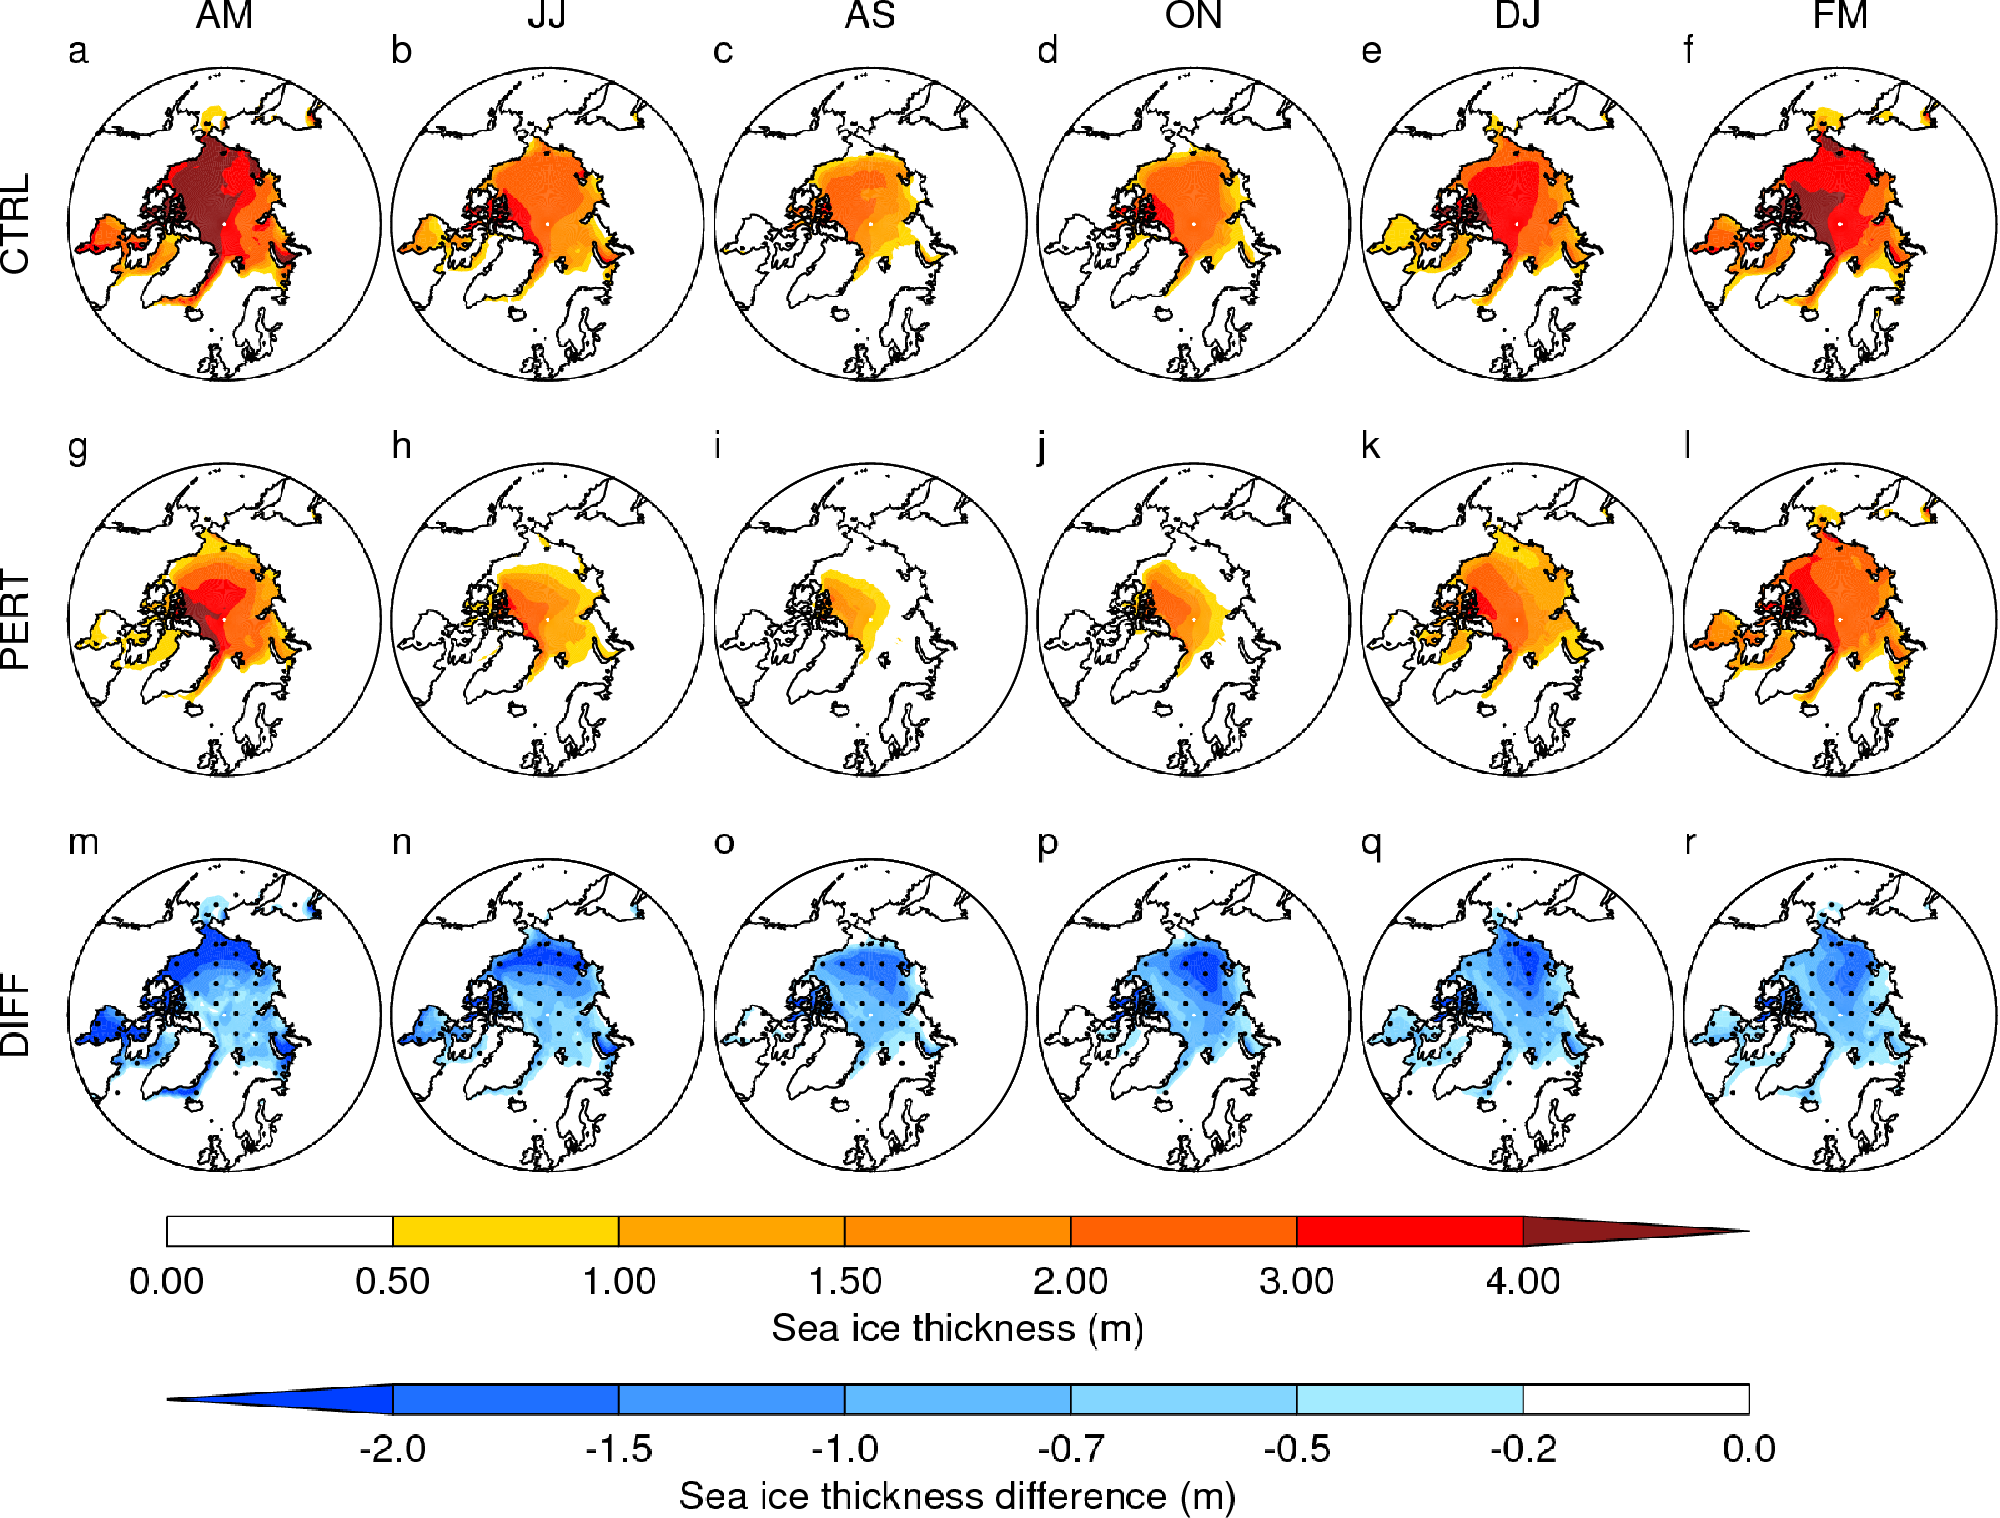
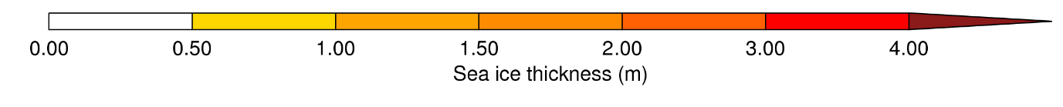
Spatial and temporal evolution of the SIT

Slide 15
Dynamic responses (I)

Slide 16
Surface air temperature
(2007-2013)-(1980-2000)
JJ
AS
ON
DJ
FM
Temperature increases ~5˚C in late Autumn, emergence of Arctic Amplification

Slide 17

August-September SIT distribution
CTRL
PERT

Slide 18
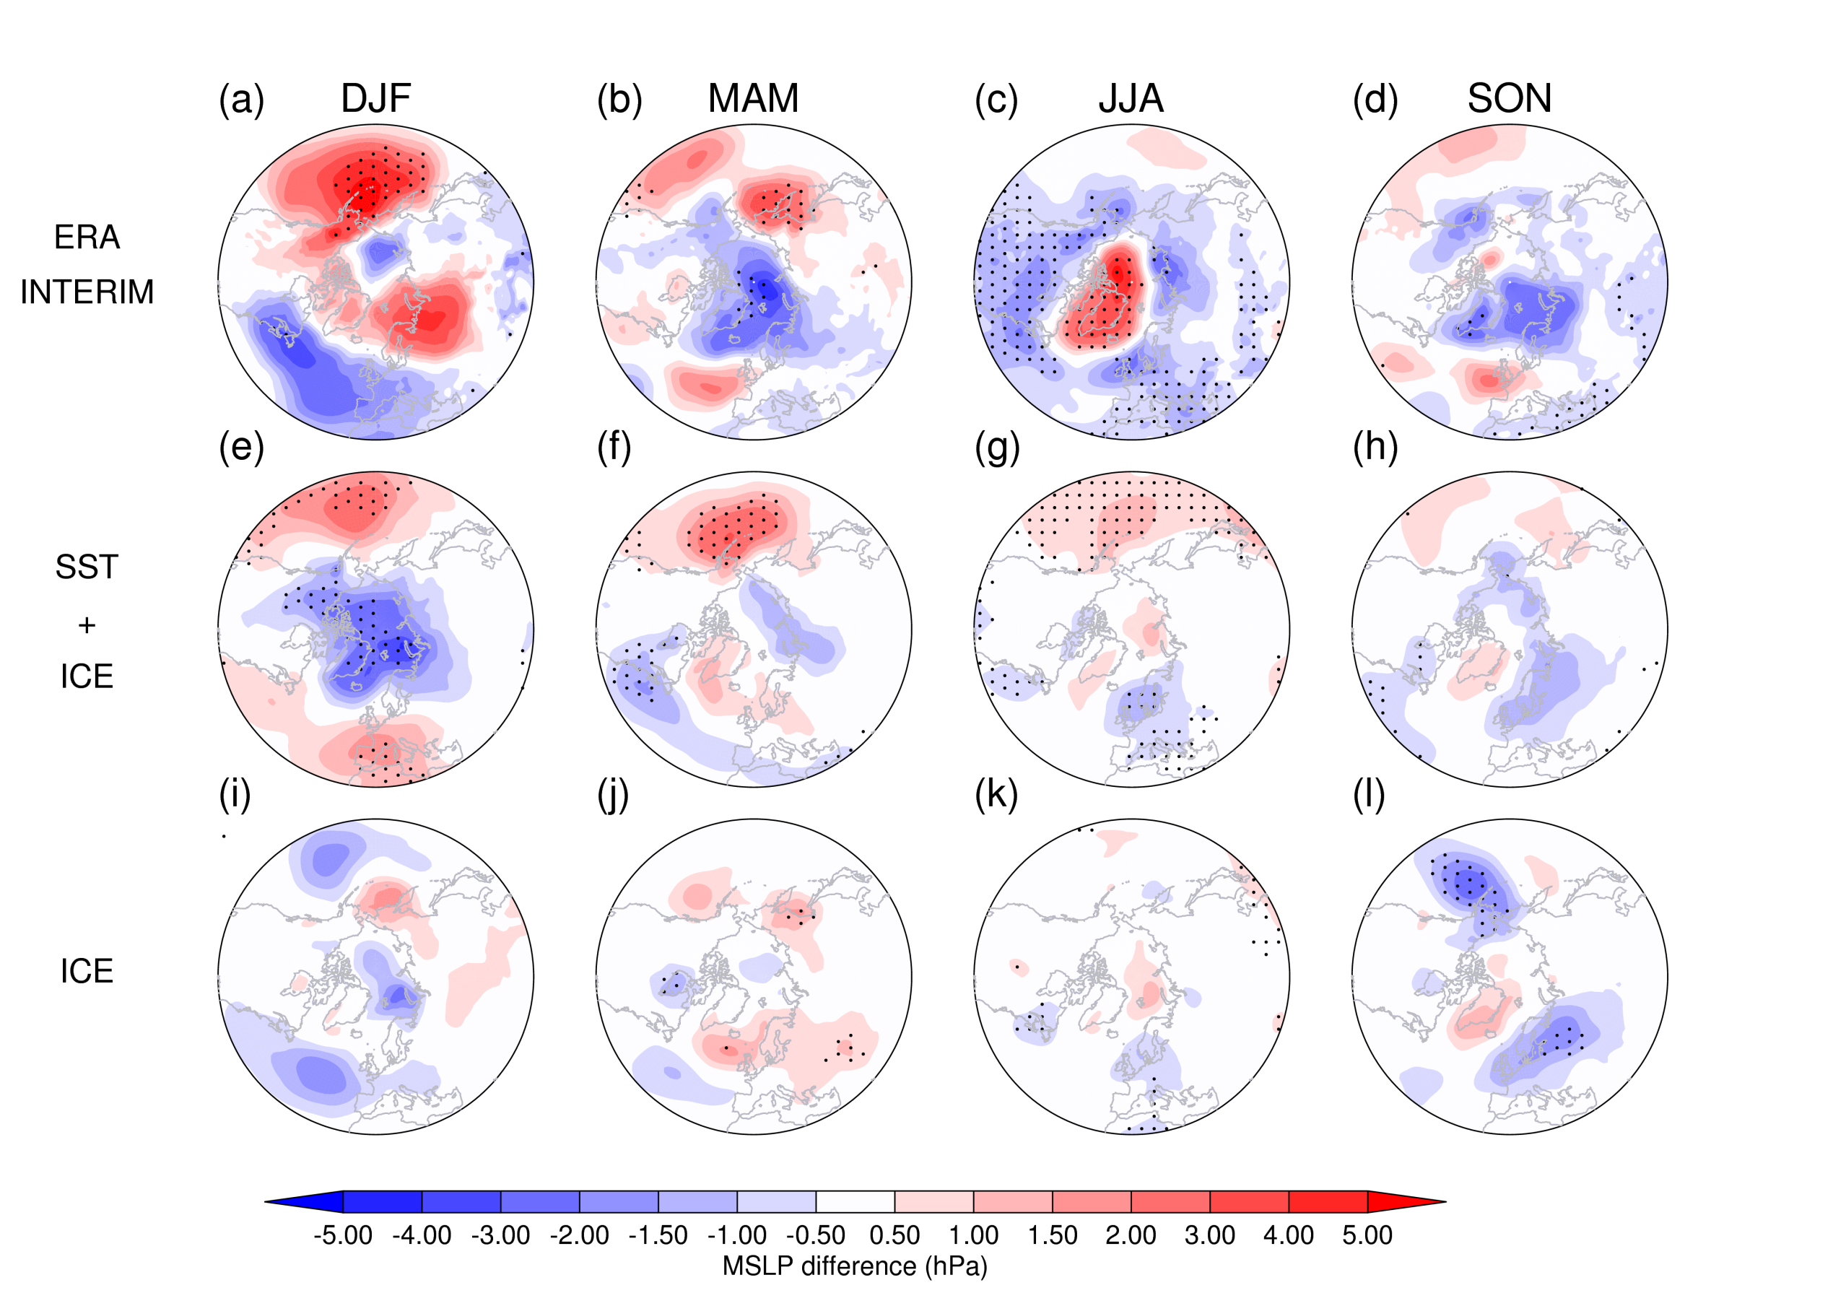

Mean sea level pressure (MSLP)
Indication of circulation change in the summer

Slide 19
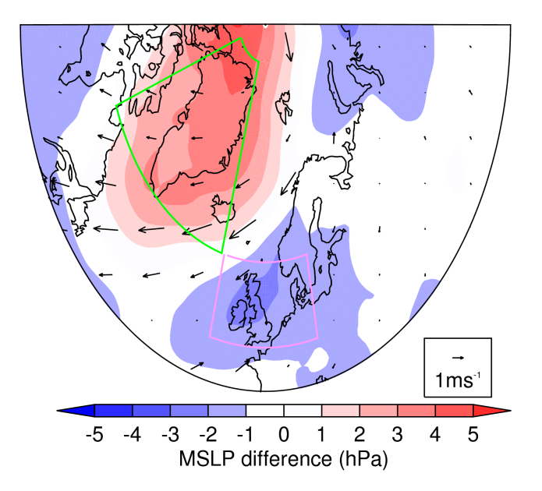
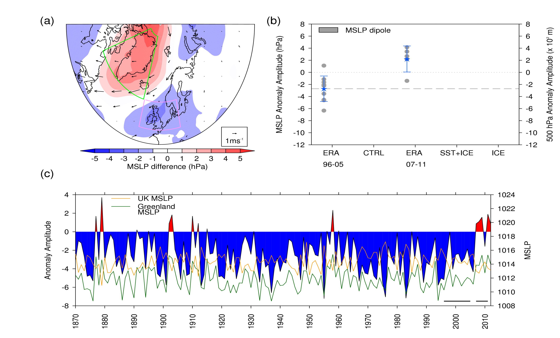

Greenland – UK DIPOLE: JJA
G-UK dipole defines the pressure
gradient between Greenland and UK
analogous to the SNAO (Folland, 2009)
ERA-Interim
DATA SOURCE | DIPOLE MEAN (hPa)
ERA: 1996-2005 | - 2.7
ERA: 2007-2011 | + 2.2

Slide 20

Greenland – UK DIPOLE: JJA
G-UK dipole defines the pressure
gradient between Greenland and UK
analogous to the SNAO (Folland, 2009)
Since 2007 there have been a
distinctive run of years where
the dipole is positive
HadSLP2

Slide 21
Why perturb the sea ice thickness?
Physically consistent way to induce low SICs in a fully-coupled simulation.
Recent declines are Arctic sea-ice are characterised by declines in both SIC and SIT.

Slide 22
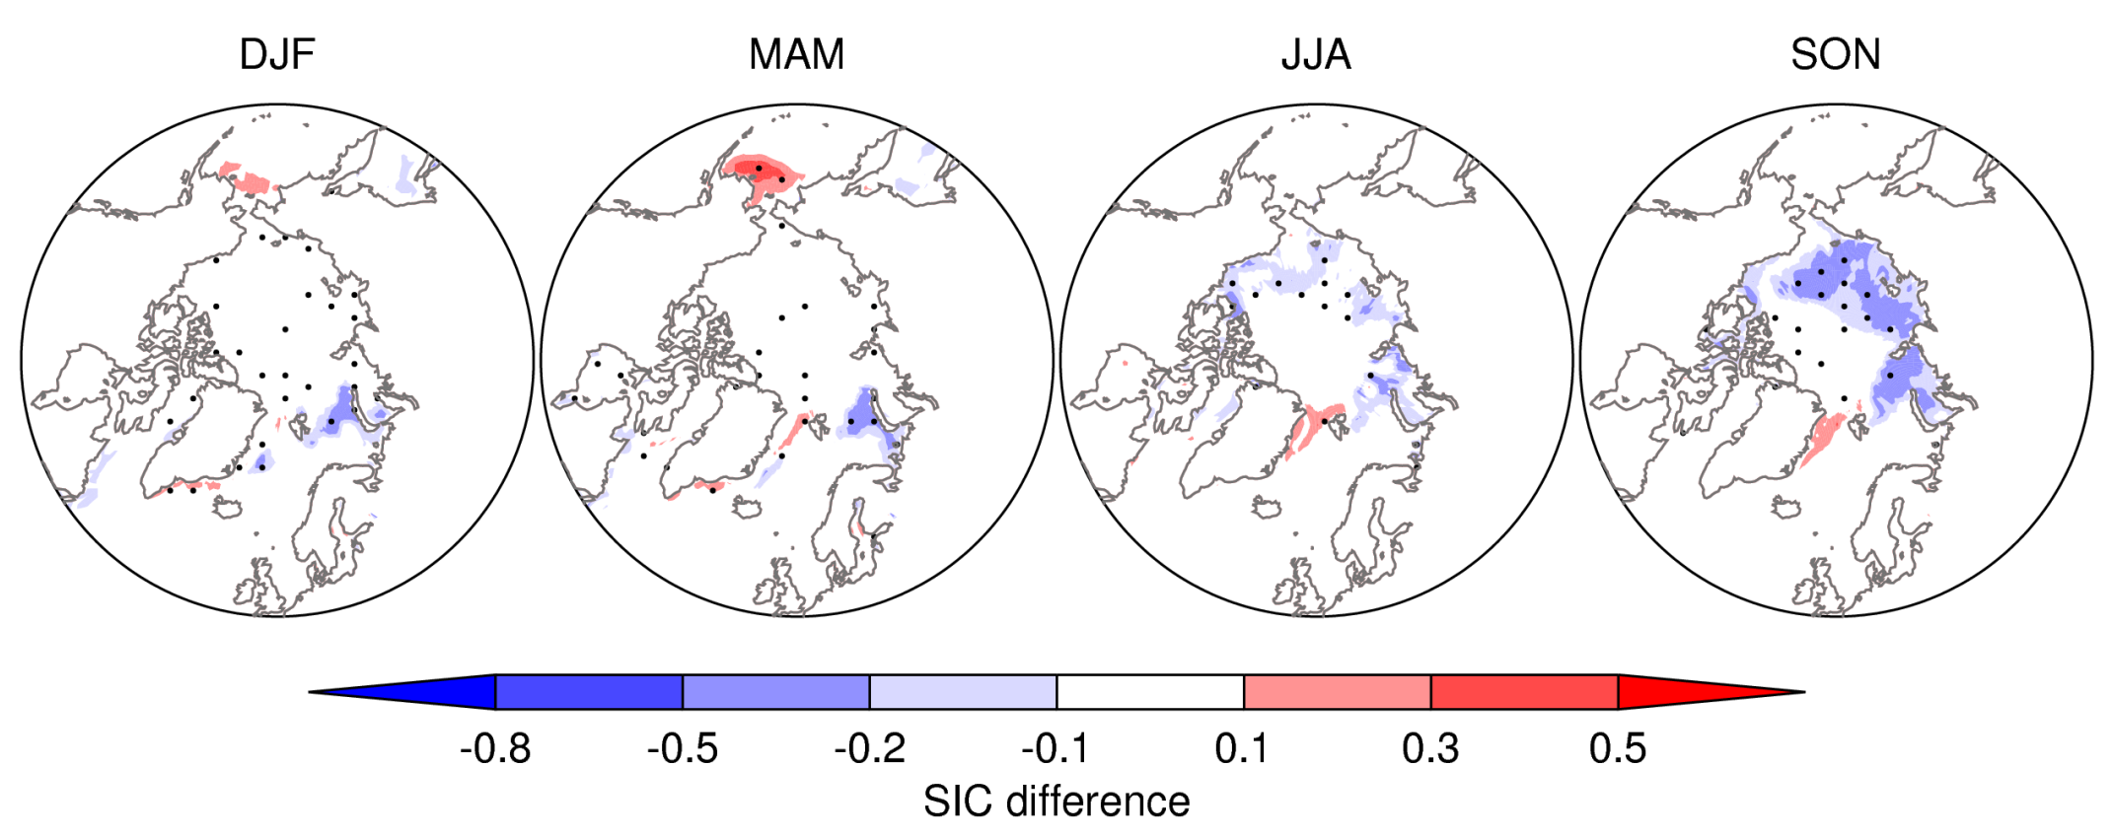
Sea-ice concentration (SIC)
(2007-2011)-(1996-2005)
Declines in SIC in Marginal seas in autumn and Barents and Kara Seas also in winter and spring.
SIC declines are seasonally and regionally dependent

Slide 23
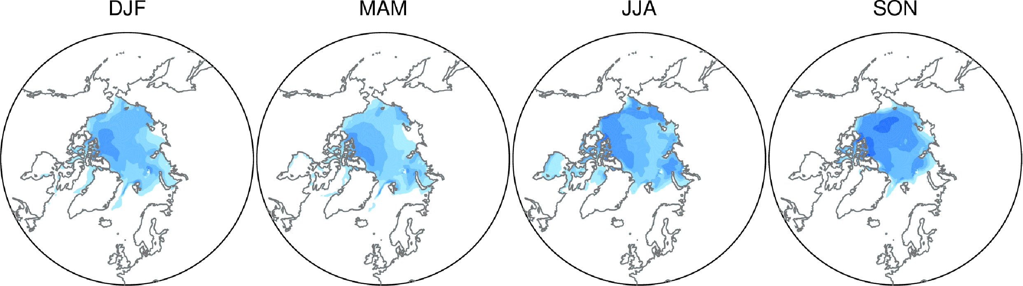
Sea-ice thickness (SIT): PIOMAS data
SIT declines are Arctic wide in all seasons

Slide 24
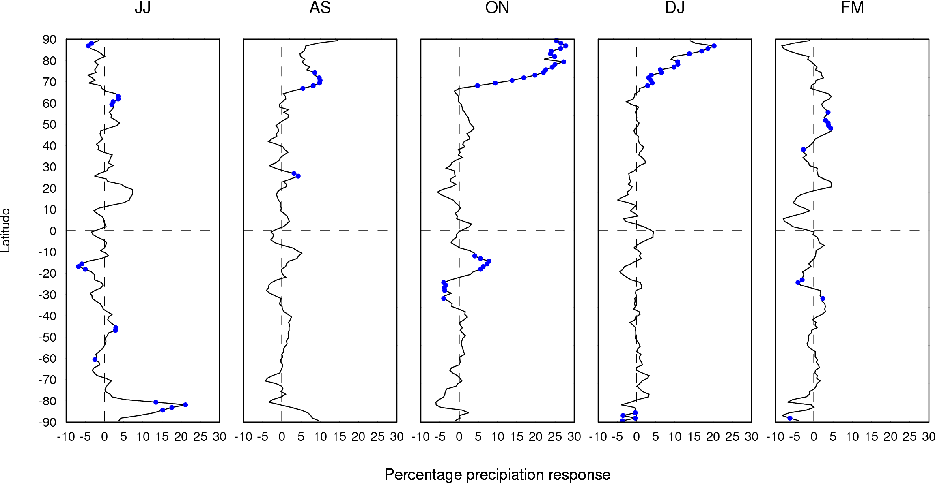
Zonal mean precipitation
Latitude
Percentage precipitation response

Slide 25
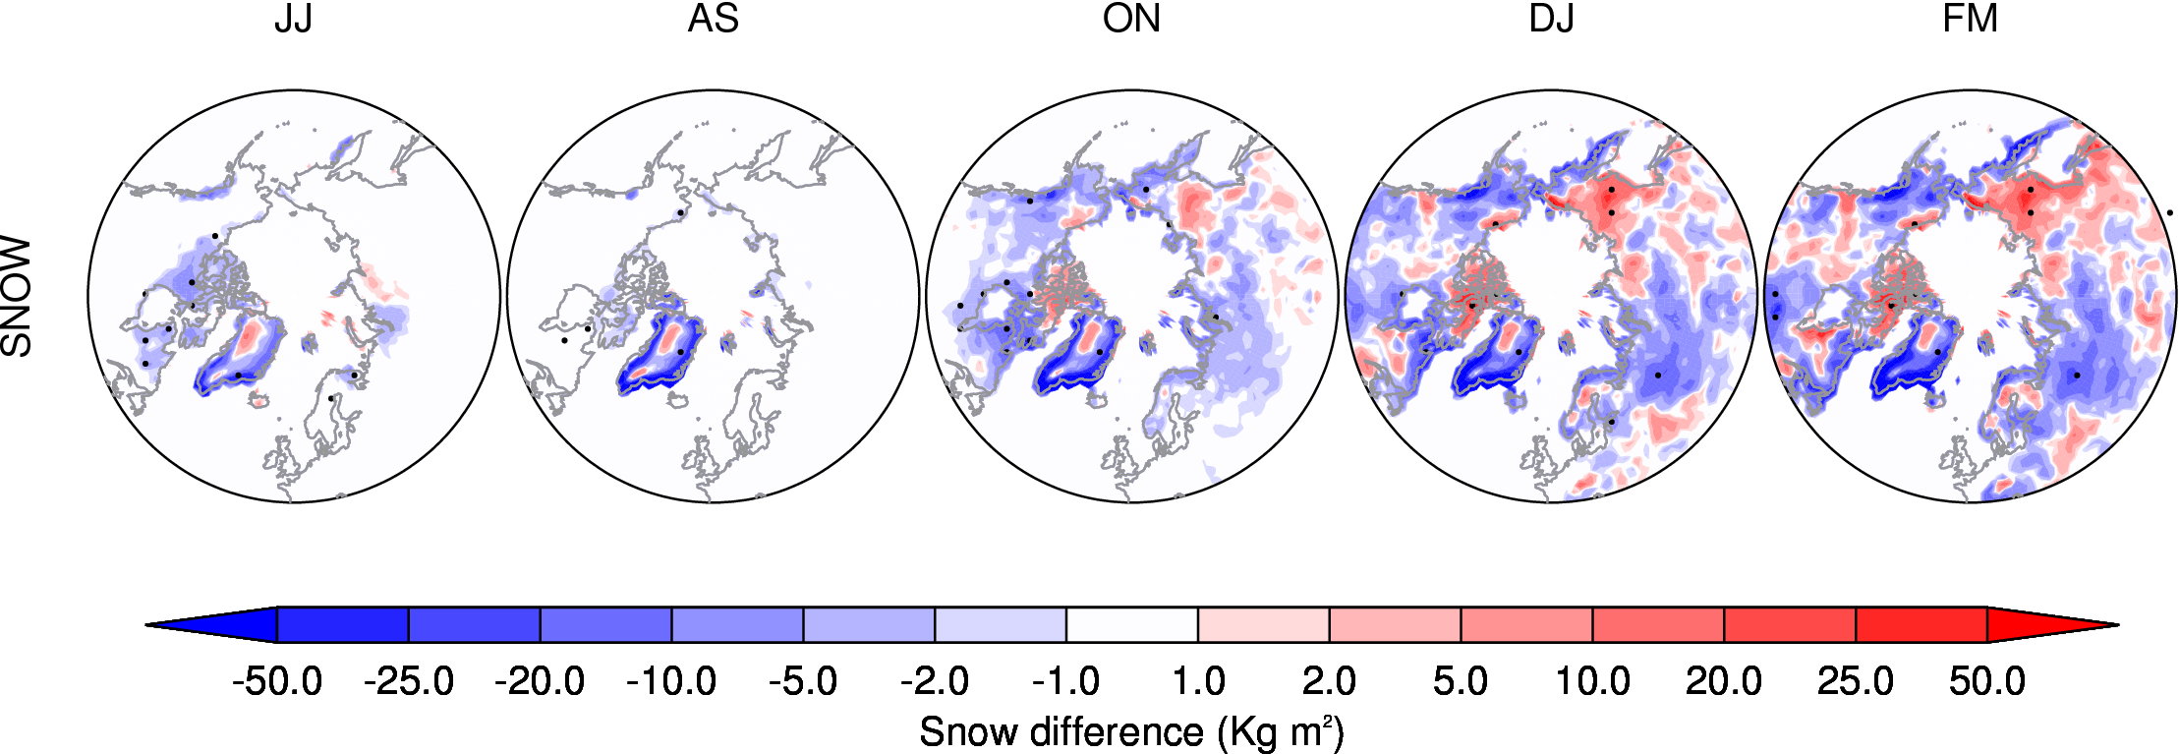
Snow cover

Slide 26
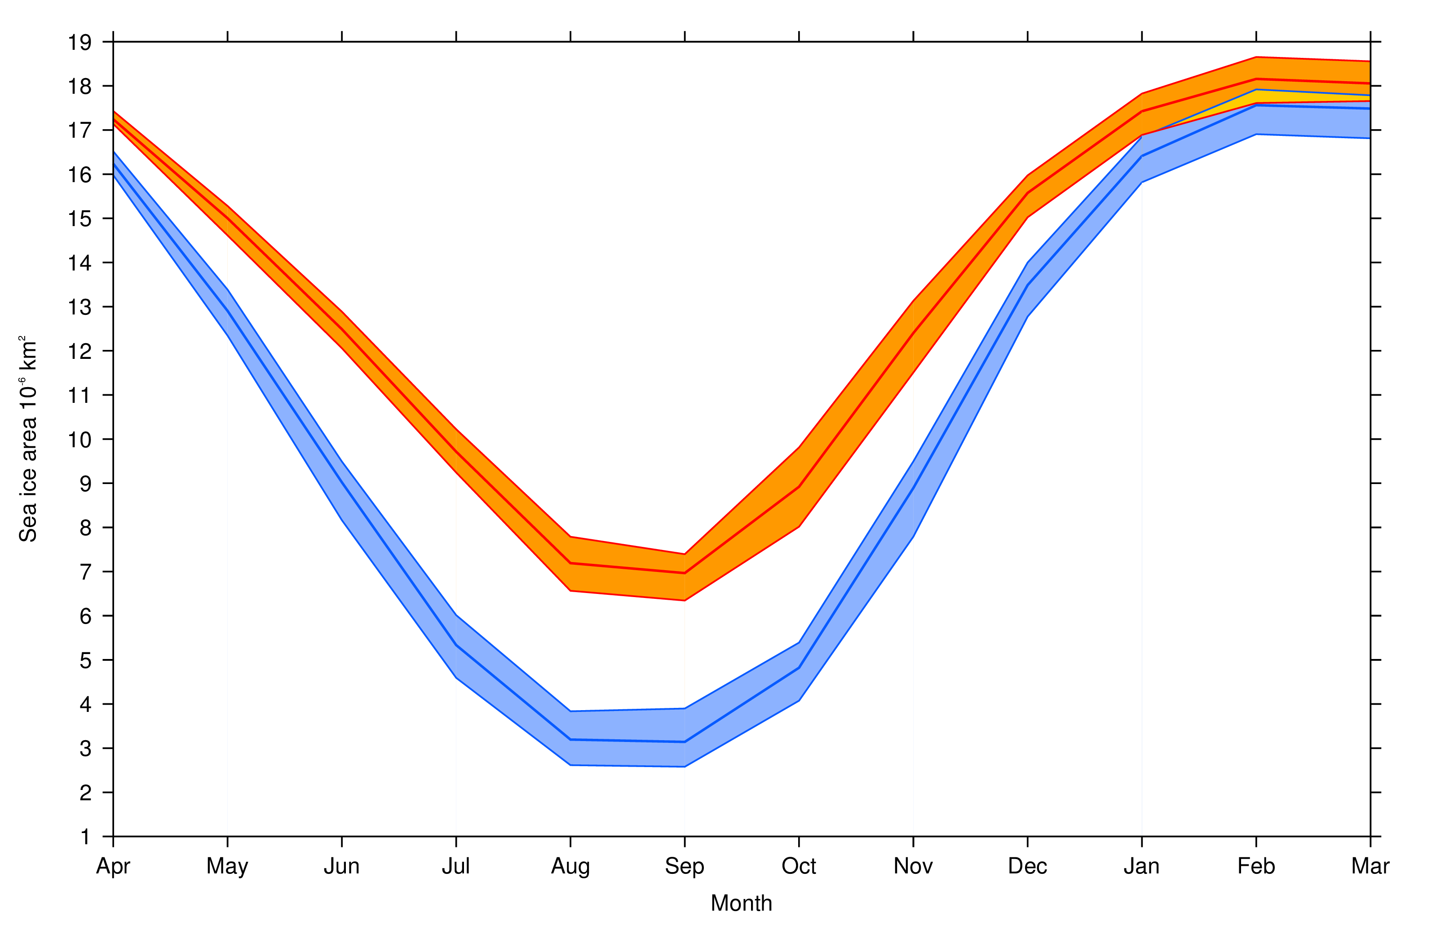
Sea-ice area evolution
CTRL
PERT

Slide 27
Thermodynamic responses
JJ
AS
ON
DJ
FM

Slide 28

Thermodynamic responses - SSTs
AS
ON

